Slide 1
Power And Data Movement GitHub: https://github.com/jasongraalum/CS533_Spring2018_Group2_Project
- Alex Kelly
-Ajinkya Shinde
-Jason Graalum
-Shikha Shah

Slide 2
Goals:
Write benchmark codes that target specific configurations expected to be power efficient or power inefficient.
Conduct a study using the benchmarks to actually measure the power consumption.

Slide 3
Hypothesis & Decision
Assumed that power consumption increases with the increase in data movement and makes code less efficient with degradation in performance.
Well, How to measure?

Slide 4
Methodology
Three Cases
Baseline(red line)
Load data into core and operate
L1 Cache Loads(orange line)
On each operation, load data from L1 to core
LLC Cache Loads(green line)
On each operation, load data from LLC to L1 to core

Slide 5
Data Movement
Initialization
For all cases, we need a consistent configuration cost
Memory allocation and initialization
Array size == 2X L1 Cache Size
Baseline
Simple operation(addition) on value in core registers
L1 Cache
Alternate between two L1 cache lines
LLC
Load from a new cache line on each access
Twice as many cache lines in the array as in L1
Guarantees that every load causes a L1 cache miss

Slide 6
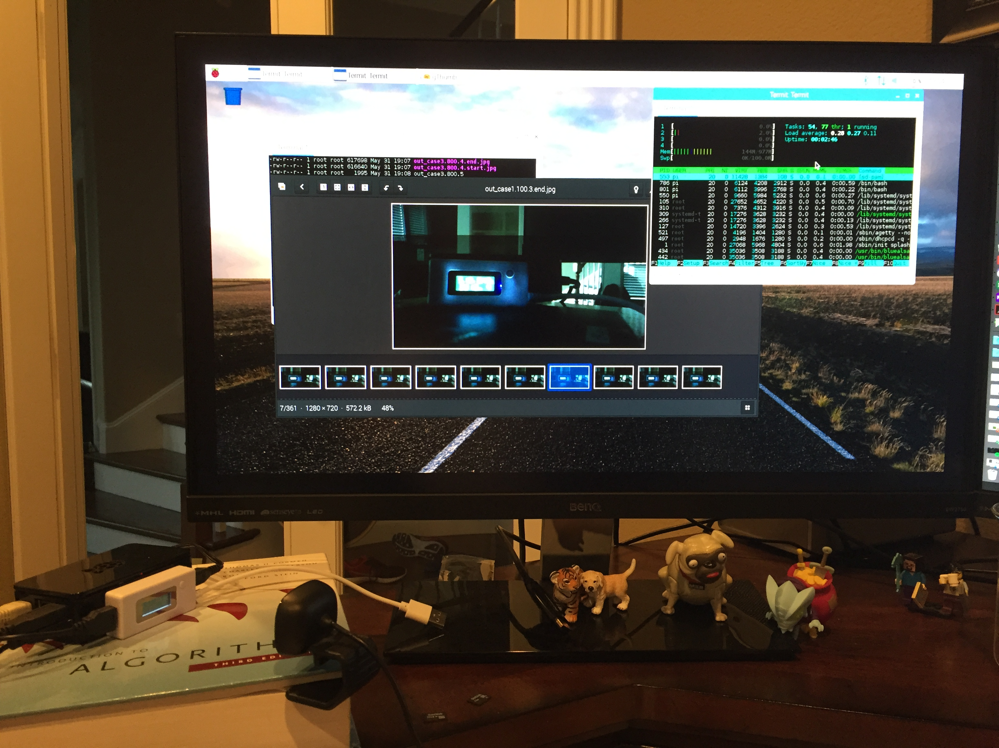
Experimental Setup
Used bash script to run multiple cases
Took photo of power meter in between each run
Found good use for Algorithms Textbook

Slide 7
Power per L1 Cache Load

Slide 8
Power per LLC Cache Load

Slide 9
Map / Reduce & Markov Model (Application – Core to Core Data Movement)
Baseline
Split Data
Core to Core
Notes:
Why was it chosen , what motivated us to do that
Process of testing :
a. Baseline
i. Move all data into L1 cache and LCC from main memory
ii. Data set should be large enough that multiple cache misses will occur
iii. Execute 4 operations on all the data on a single core.
iiii. Store data in main memory from single core L1
b. Split Data
i. Move ¼ of the data from main memory into L1 cache of each core
ii. Execute 4 operations on all the data in each core
1. Large data – multiple fills of L1 cache
iii. Store data in main memory from each core L1 cache
c. Core to Core
i. Move ¼ of the data into each L1 cache of each core
ii. Execute 1 operation in each core
iii. Store data back in main memory
iv. Shift data to each core and repeat for each of the 3 remaining operations

Slide 10
Results
Add Graphs

Slide 11
Conclusion
Explain Result

Slide 12
References

Slide 13
Back up slides

Slide 14
Raspberry Pi 3
Why did we use a Raspberry Pi 3?
Ease of use
Easy Access
Easy Configuration
Power measurement through USB power supply
Was it a good decision?

